Slide 1
Case Study
SE Principles and Qualities in a Compiler

Slide 2
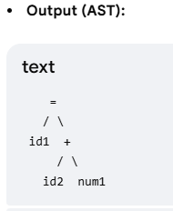
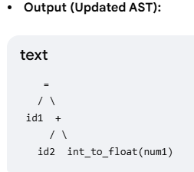
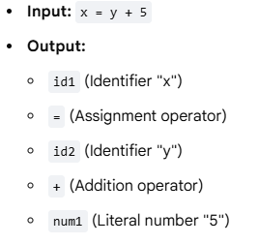
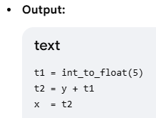
Components of a Compiler
Lexical Analyzer (Scanner)
  Read source code character by character, group them into meaningful tokens (s.a. keywords, identifiers, operators)
Syntax Analyzer (Parser)
  Arrange tokens into a tree structure (called parse tree or AST
  Compare the tree with grammar rules and identify non-compliances
Semantic Analyzer
  Check for logical and meaning-based errors s.a. type mismatch, using an undeclared variable etc.
Intermediate Code Generator
  Generate machine-independent intermediate representation
  Bridge between HL source code and the low-level target code

Slide 3
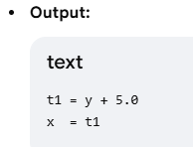
Components of a Compiler
Code Optimizer
  Improves intermediate code so that final program runs faster and uses less memory
Code Generator
  Translate the optimized intermediate code to target language (usually low-level assembly language or machine language)
Output (Assembly Code)
LDF R2, y ; Load variable y into Register 2
ADDF R2, R2, #5.0 ; Add 5.0 to Register 2
STF x, R2 ; Store the result from Register 2 into variable x
Code proposed by LLM, use with caution.

Slide 4
Software Engineering and Other Disciplines

Slide 5
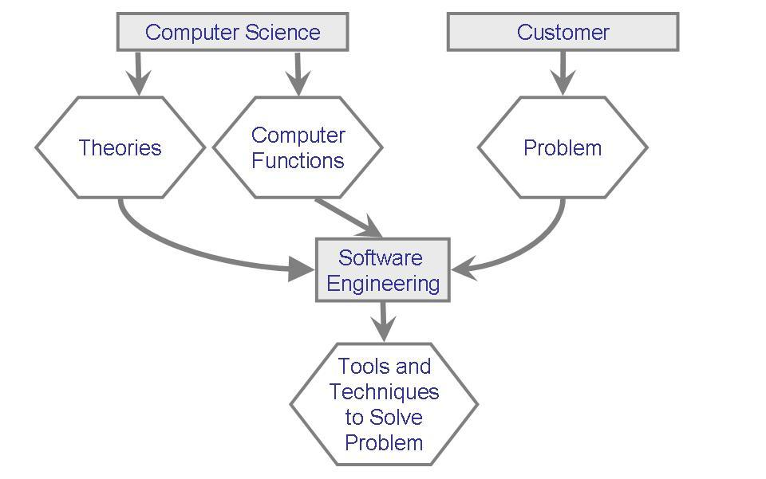
Software Engineering and Computer Science

Slide 6
SE and CS
Programming Languages
  Modularity
  Exception handling
Operating Systems
  Early software which were engineered
Databases
  Components of large systems
Artificial Intelligence
Theoretical CS

Slide 7
Software Engineering and Management Science
Multi-person endeavor
Project Estimation
Project Scheduling
Human Resource Planning
Task Decomposition
Task Assignment
Project Tracking
Hiring people, motivating people etc.

Slide 8
SE and Systems Engineering
Consider complex systems e.g. chemical plants, factory monitoring system, flight control system, buildings, bridges
Software is often a component of a larger system
Software engineer should take broader look
  Understand application area
Flexibility vs Performance

Slide 9
SE and Other Disciplines
Civil Engineering
Mechanical Engineering
Computer (Hardware) Engineering
Medicine???

